Slide 1

2026
Notes:
Hello everyone! My name is Kathy Foor, and I am the Director of Women’s Ministries for the Churches of God General Conference. I’d like to take a few moments today to share what CGWM is and what we are doing.

Slide 2

Our Purpose: To provide training to leaders and potential leaders.
Mission: To train leaders to connect and equip women to live boldly for God.
Vision: To see women discipling women.
Notes:
Because the Churches of God, General Conference (CGGC) considers the role of women to be so vital to the church's effective ministry, they believe it is important for women to have an organized ministry that is in harmony with the total ministry of the church. The Churches of God Women's Ministries (CGWM) is an active organization of women that is accountable to the Churches of God, General Conference.
Our purpose is to train leaders to connect and equip women to live boldly for God, and in that to see women disciples of Christ who are actively disicpling others. Ohio.

Slide 3
Thank Offering
2025 Thank Offering Disbursement
It is exciting to report that our 2025 Thank Offering totaled $15,200.43 . Of that, $9,120.26 was disbursed to the following ministries supported by CGMW:
Leadership Training 25% $2280.00
Winebrenner Seminary 25% $ 2280.00
Haiti Physical Therapy School 20% $1824.00
Venezuela Bible School 15% $1368.00
Nursing Scholarships in South Central Asia 15% $1368.69
Total $9,120.26

Slide 4
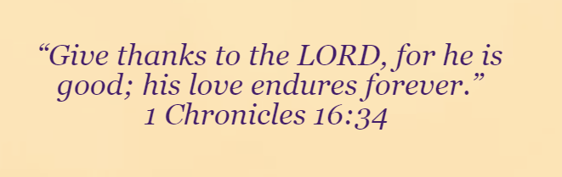
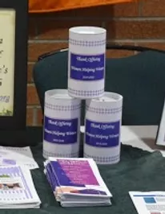
Thank Offering
2026 Thank Offerings will support:
Women’s Leadership Development (25%)
Winebrenner Female Students (25%)
Physical Therapy School in Haiti (20%)
Nursing Scholarships in South Central Asia (15%)
Venezuela Bible School (15%)

Slide 5
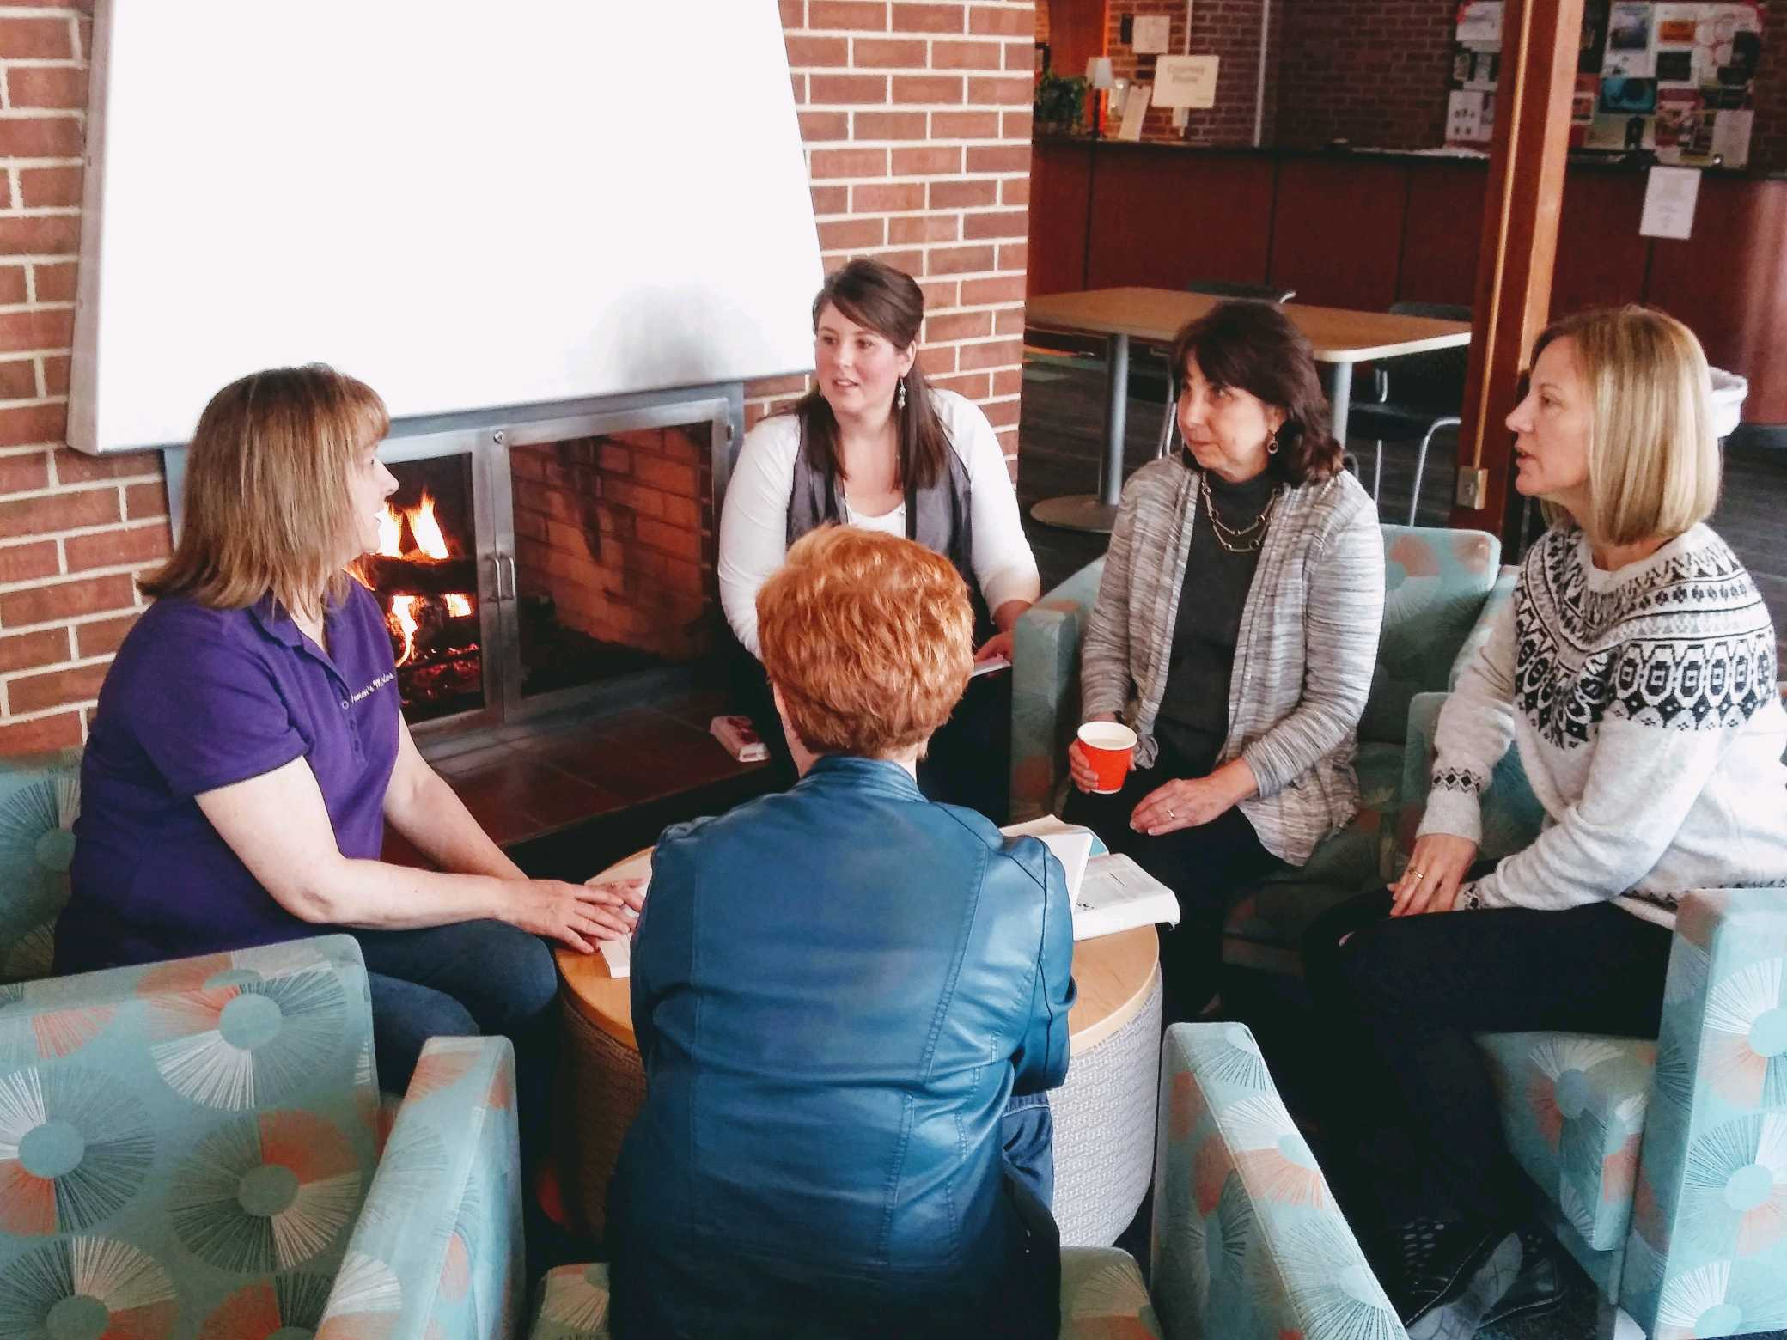

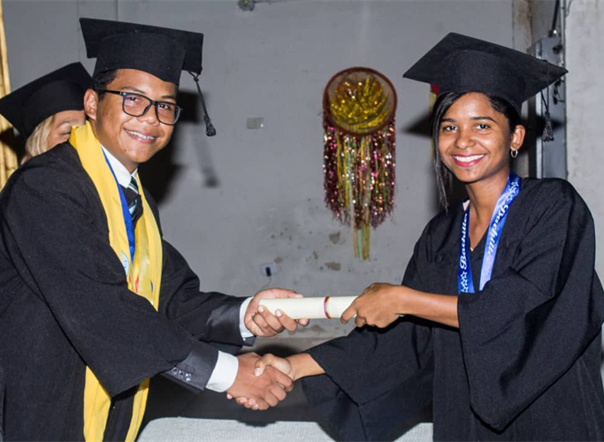
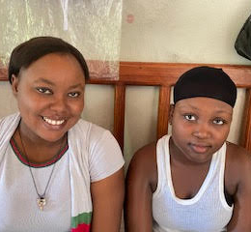
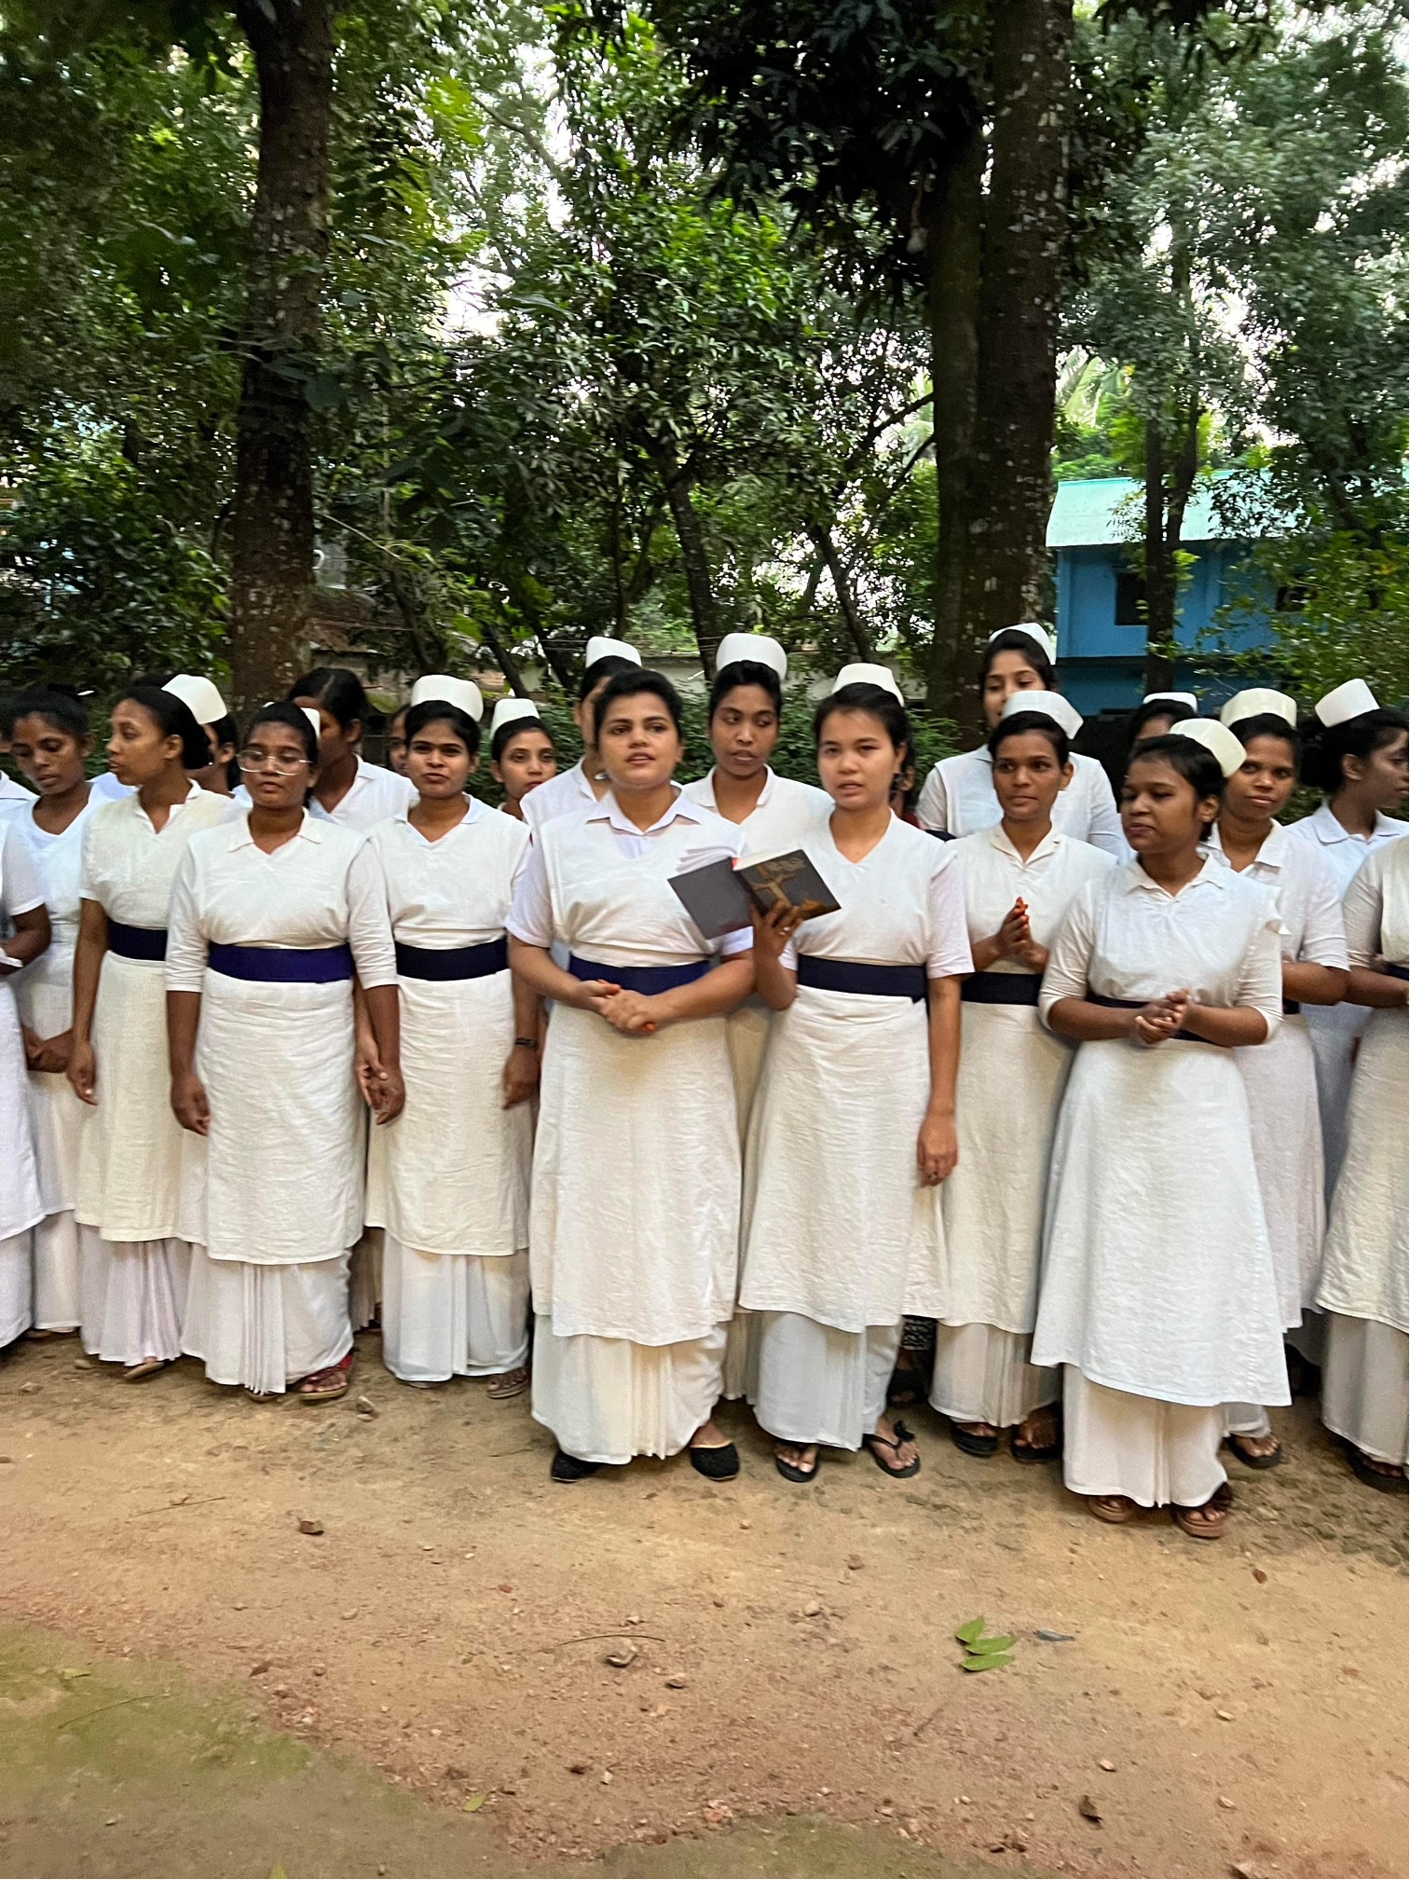
2026 Thank Offering will Support
Women at Winebrenner Theological Seminary 25%
Women’s Leadership Development 25%
VENEZUELA BIBLE SCHOOL 15%
Physical Therapy School in Haiti 20%
Nursing Scholarships in South Central Asia 15%

Slide 6
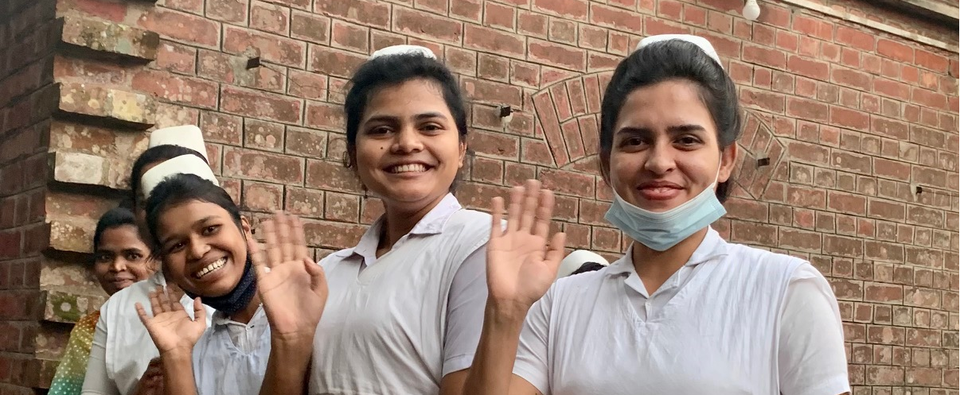
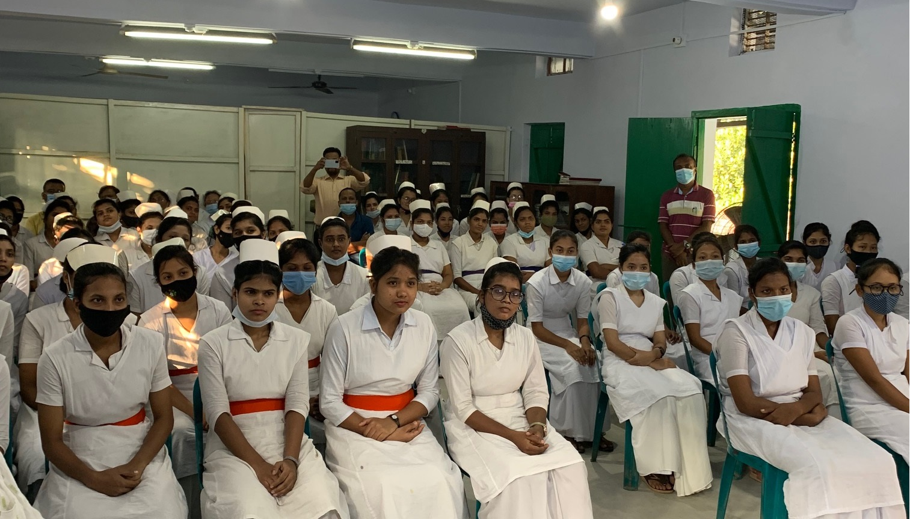
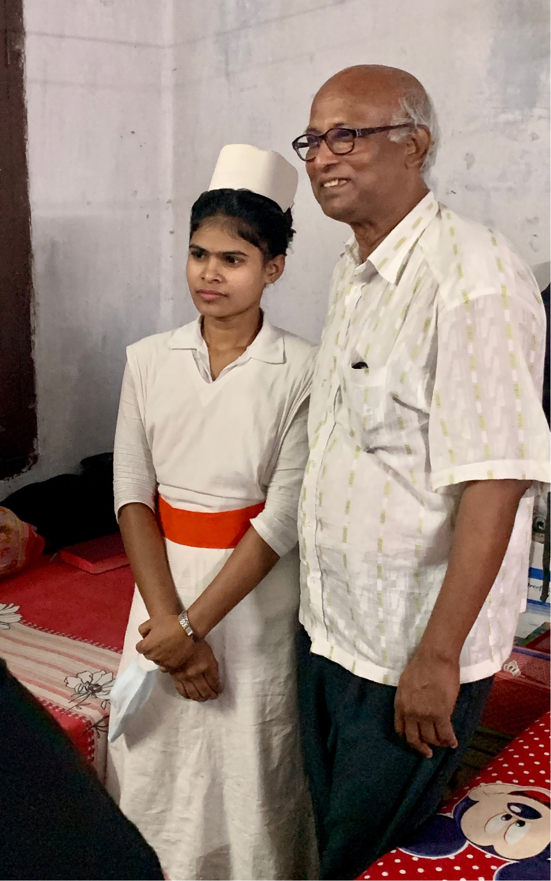
Nursing Scholarships in South Central Asia

Slide 7
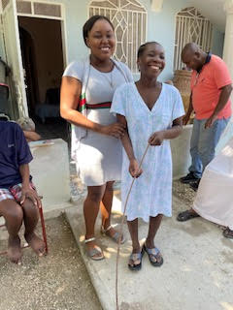
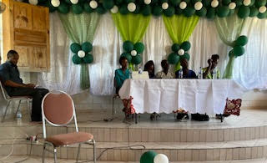
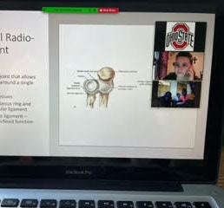
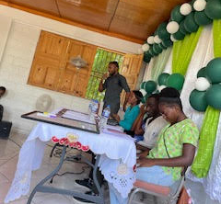
Physical Therapy School in Haiti

Slide 8
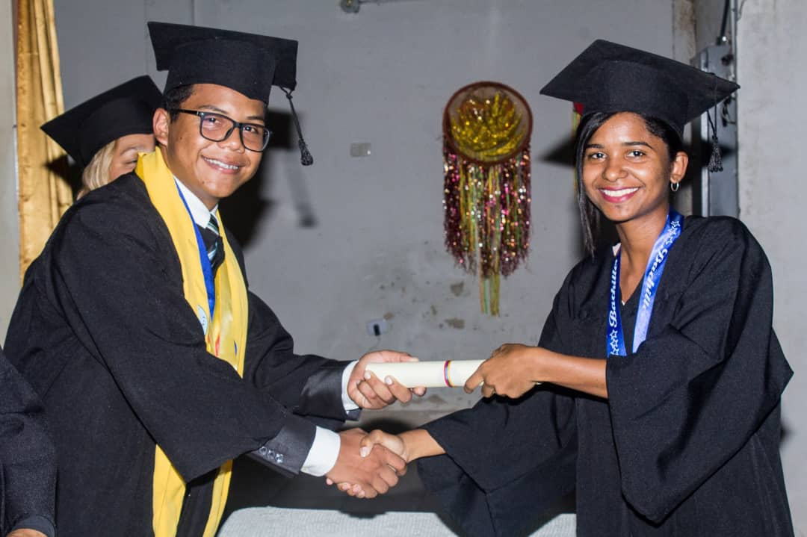
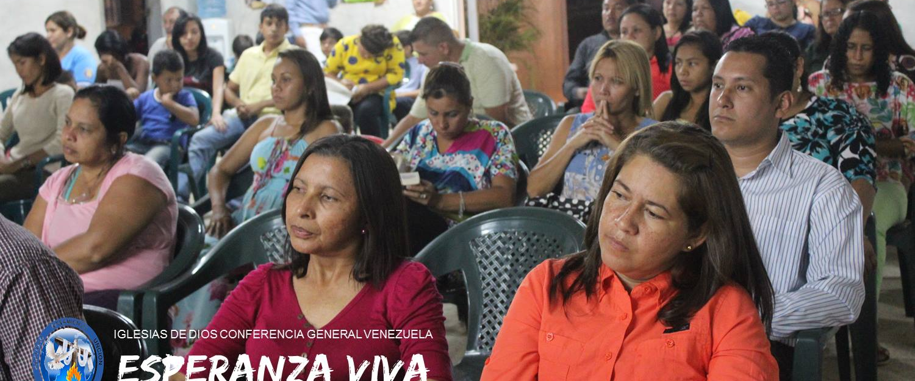
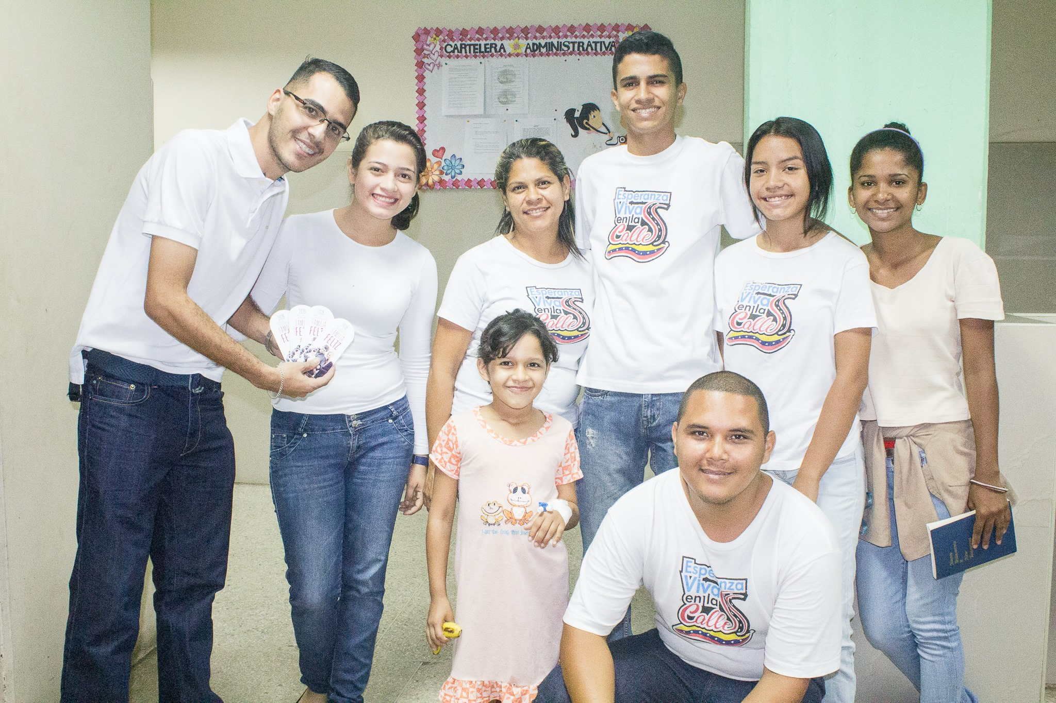
VENEZUELA BIBLE SCHOOL

Slide 9
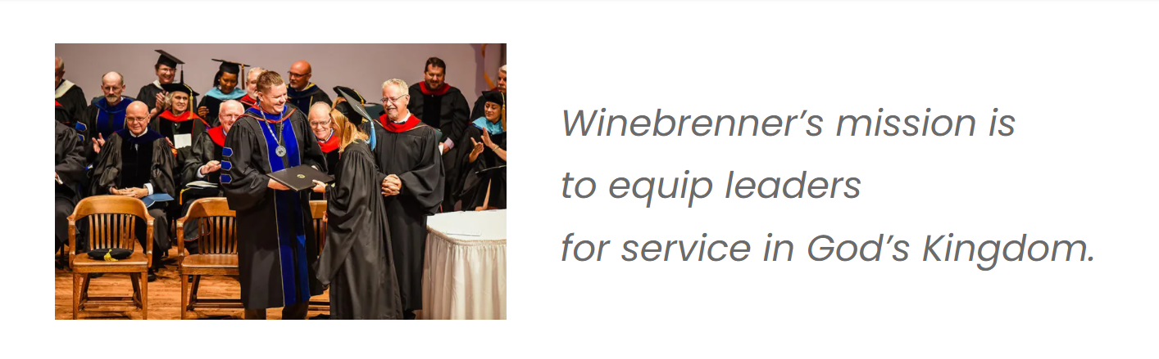
Women at Winebrenner Theological Seminary

Slide 10
Women’s Leadership Development

Slide 11
Thank Offering
Learn more at…
https://www.cggcwomen.org/thank-offering

Slide 12


Slide 13
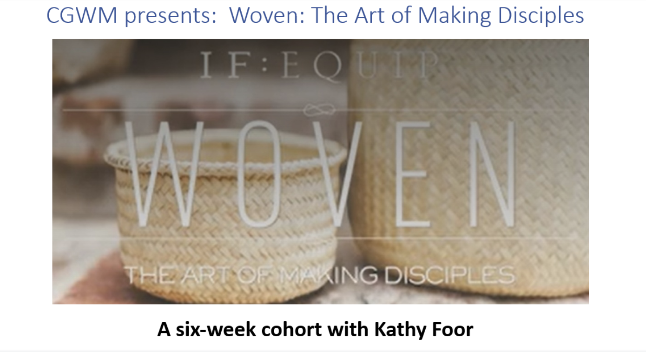
Interested?
Email Kathy
at cgwmdirector@gmailcom
A Right Now Media Production

