Slide 1
2024
Notes:
Hello everyone! My name is Kathy Foor, and I am the Director of Women’s Ministries for the Churches of God General Conference. I’d like to take a few moments today to share what CGWM is and what we are doing.

Slide 2
Our Purpose: To provide training to leaders and potential leaders.
Mission: To train leaders to connect and equip women to live boldly for God.
Vision: To see women discipling women.
Notes:
Because the Churches of God, General Conference (CGGC) considers the role of women to be so vital to the church's effective ministry, they believe it is important for women to have an organized ministry that is in harmony with the total ministry of the church. The Churches of God Women's Ministries (CGWM) is an active organization of women that is accountable to the Churches of God, General Conference.
Our purpose is to train leaders to connect and equip women to live boldly for God, and in that to see women disciples of Christ who are actively disicpling others. Ohio.

Slide 3
Thank Offering
Thank Offering Disbursement
It is exciting to report that our 2023 Thank Offering totaled $18,204.48. Of that, $10,922.69 was disbursed to the following ministries supported by CGMW:
Leadership Training 25% $2731.00
Winebrenner Seminary 25% $2731.00
Haiti Physical Therapy School 20% $2185.00
Venezuela Bible School 15% $1638.00
Madhumita Singha (nursing school) 15% $1637.69
Total 100% 10,922.69

Slide 4
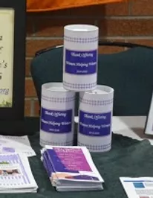
Thank Offering
2024 Thank Offerings will support:
Bogra Christian Hospital Nursing Scholarships in Bangladesh (15%)
Venezuela Bible School (15%)
Physical Therapy School in Haiti (20%)
Winebrenner Female Students (25%)
Women’s Leadership Development (25%)

Slide 5
Bogra Christian Hospital Nursing Scholarships

Slide 6
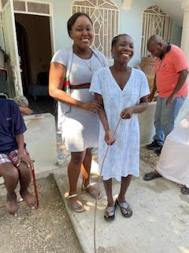
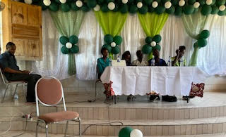
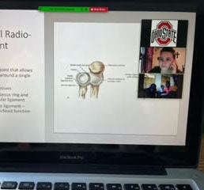
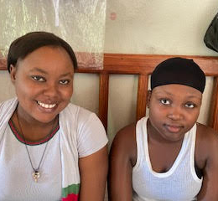
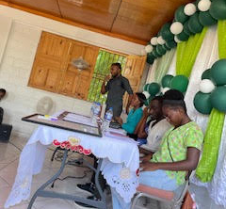
Physical Therapy School in Haiti

Slide 7
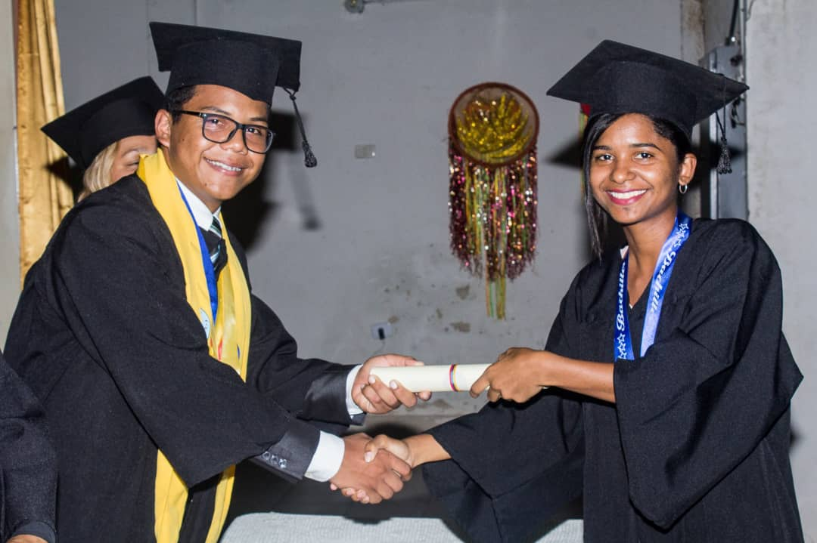
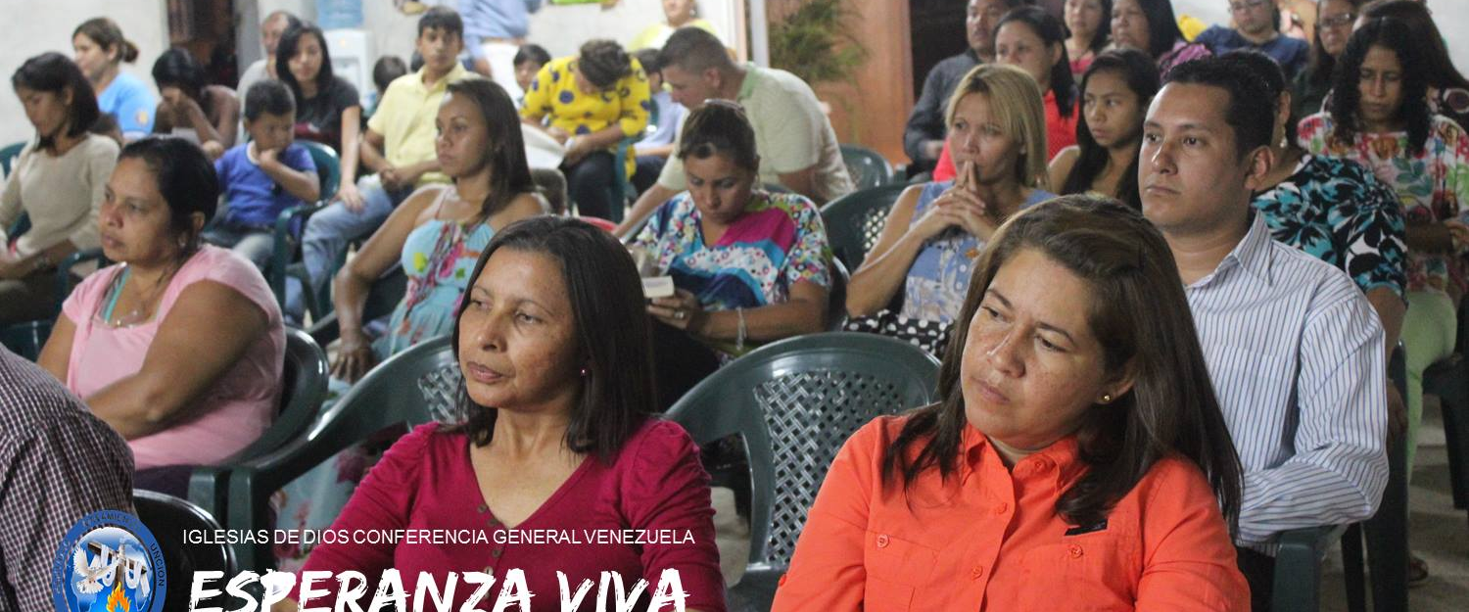
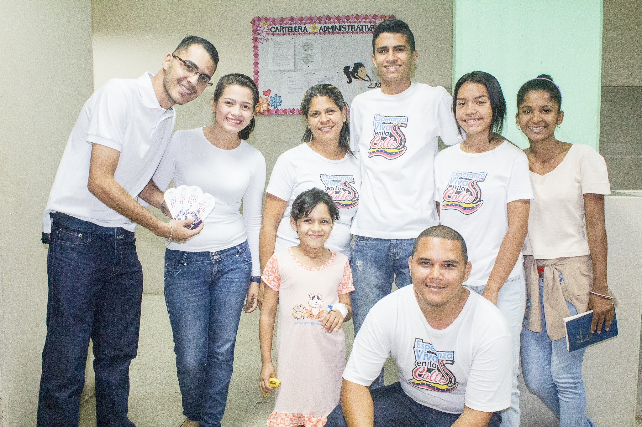
VENEZUELA BIBLE SCHOOL

Slide 8
Women at Winebrenner Theological Seminary

Slide 9
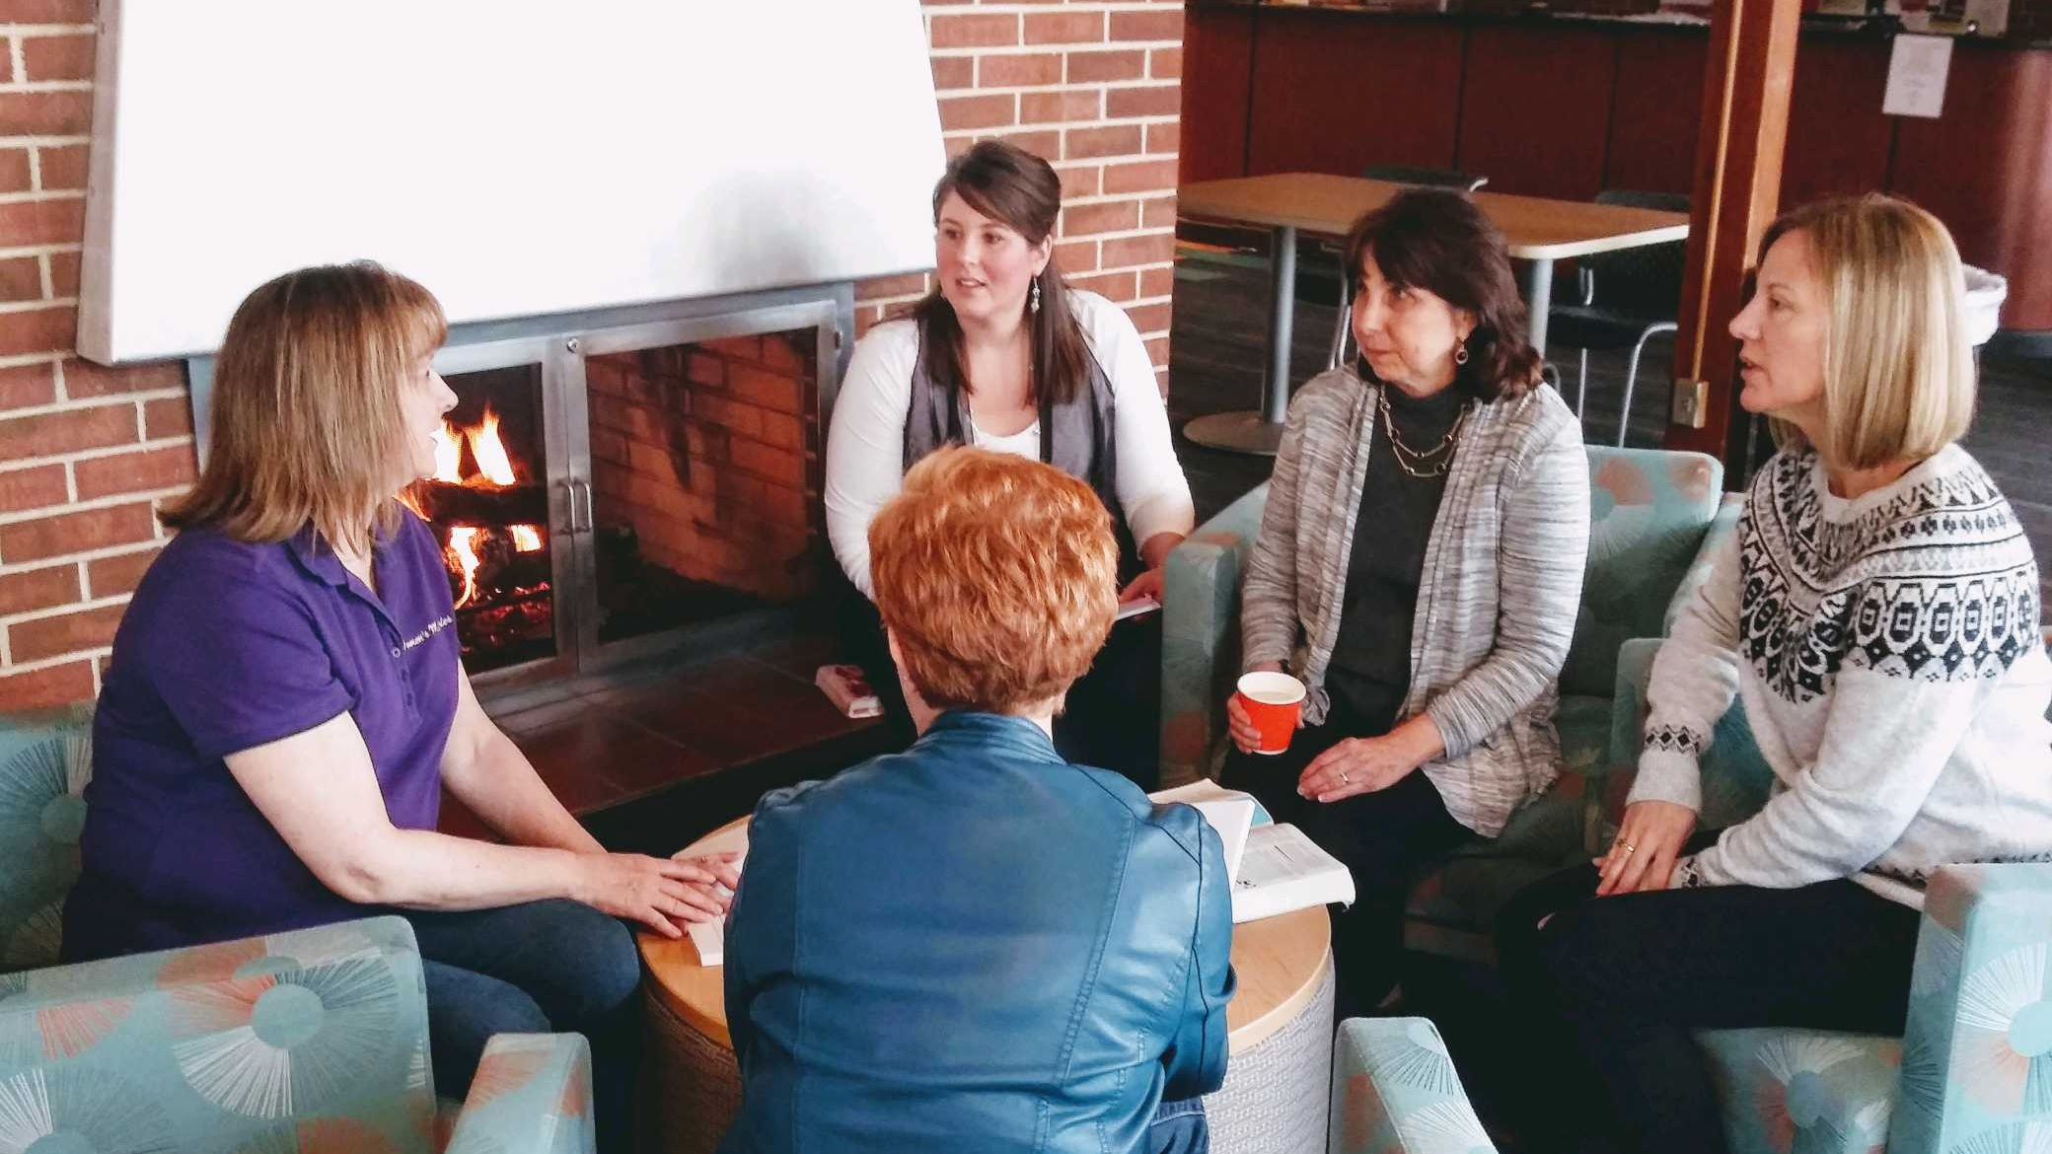
Women’s Leadership Development

